Slide 1



FINANCIAL DASHBOARD
BY NANDINI GANTAYAT
MSC BIG DATA ANALYTICS FOR BUSINESS
FINANCIAL PROGRAMMING PROFESSOR – MINH PHAN

Slide 2
PROJECT DESCRIPTION
Creating a financial dashboard using python in streamlit
To give a sneak peek into the world of S&P 500
Provide a robust interactive interface to stock enthusiasts
Replicating the yahoo finance website
Giving user the flexibility to choose duration and stock price for decision making
Different tabs built to ease the decision making process of investing in a stock

Slide 3
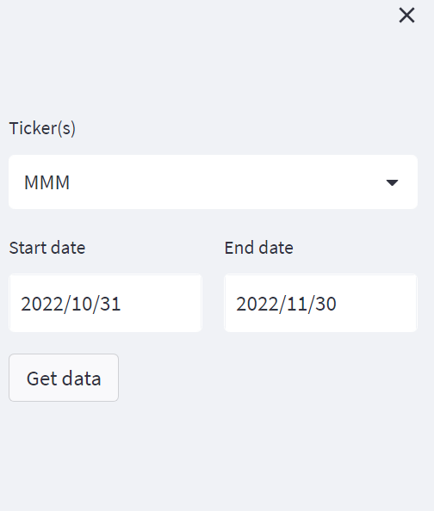
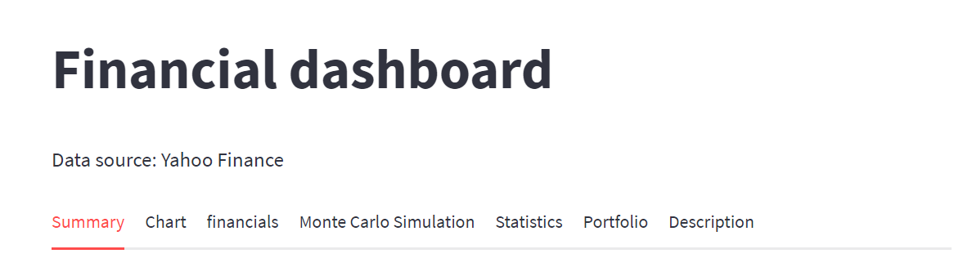
TAB 0
Gives user the flexibility to choose the desired tickers and date

Slide 4
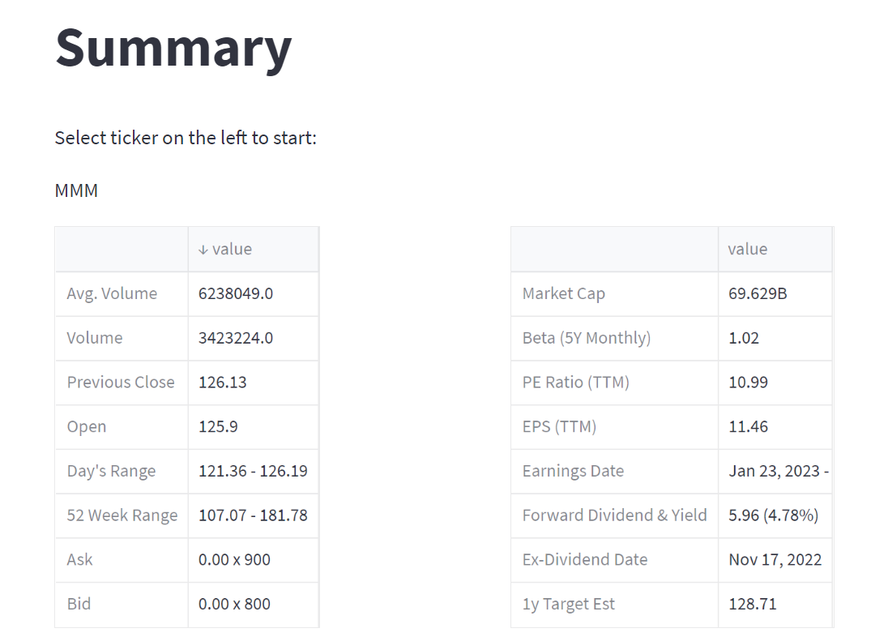
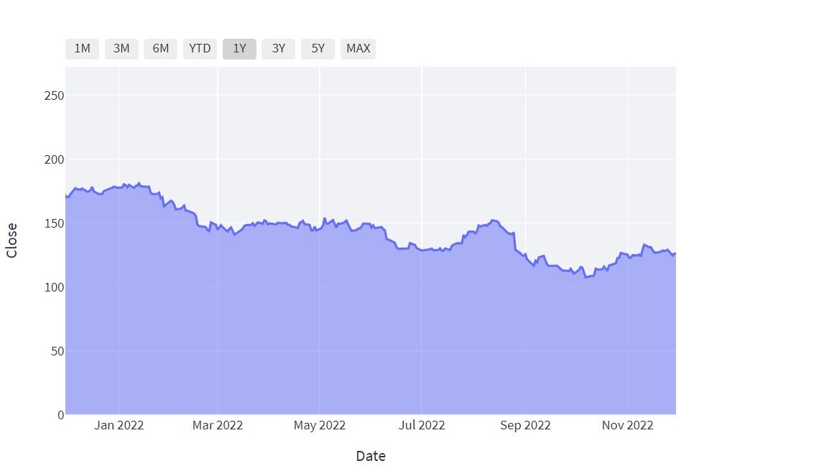
TAB 1
For Viewing important statistics
For Viewing trend of close price for selected period

Slide 5
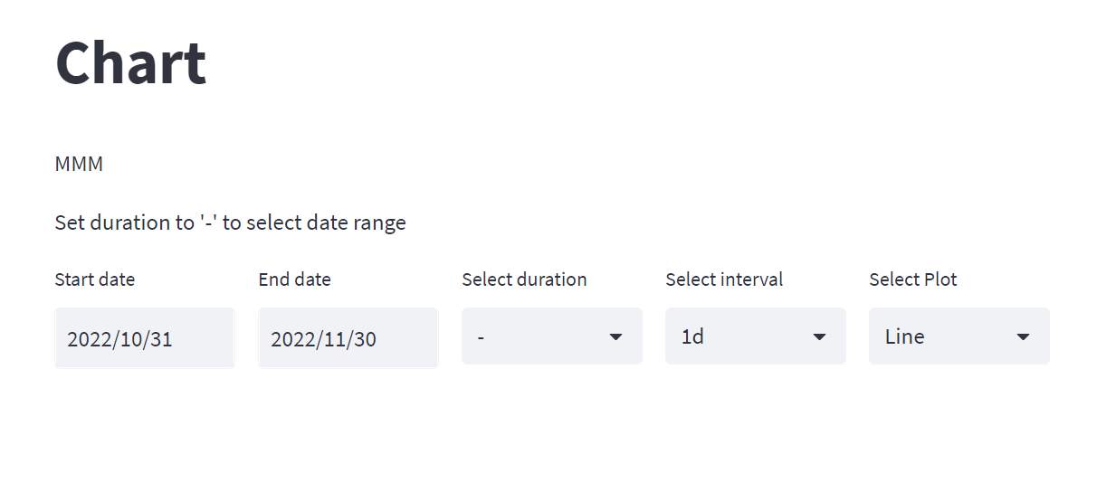
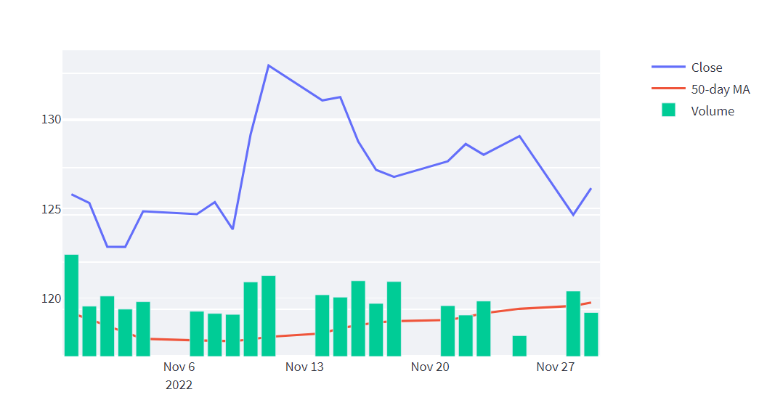
TAB 2
View plots of moving averages for the selected tickers

Slide 6
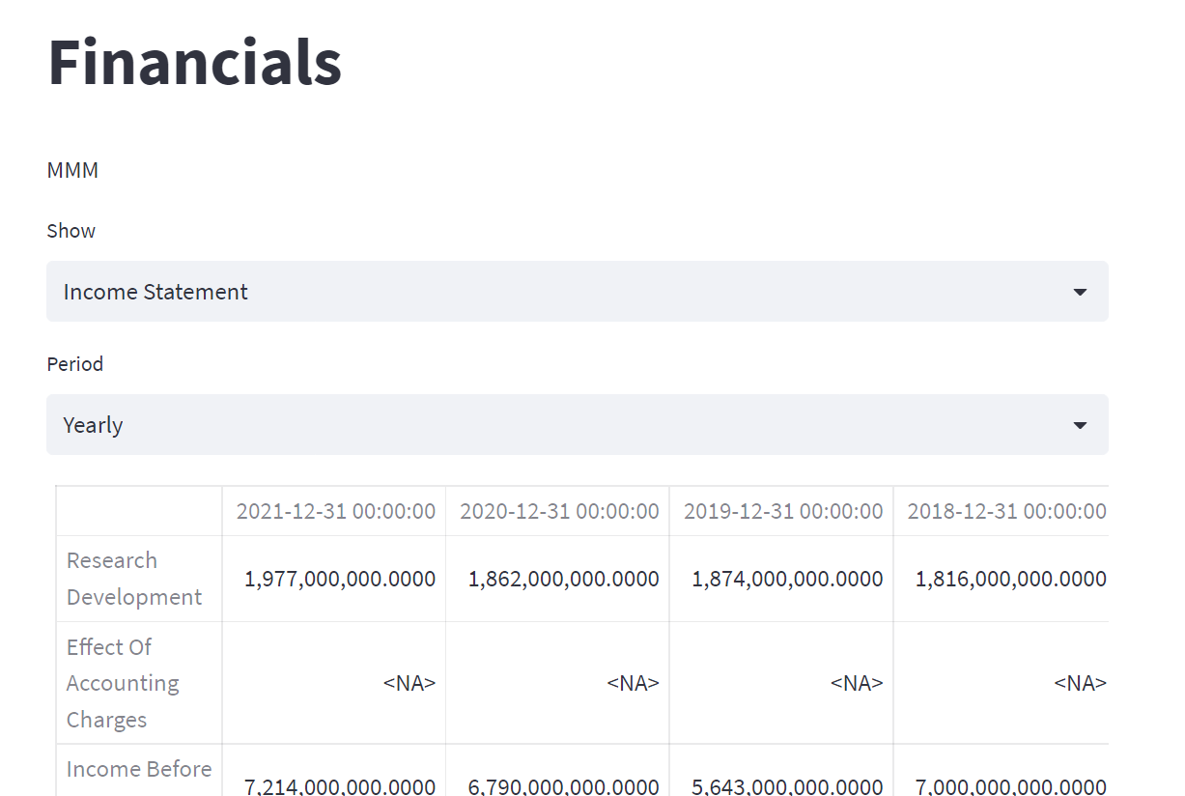
TAB 3
View all financial statements like income statement, cash flow and balance sheet with the option for period selection

Slide 7
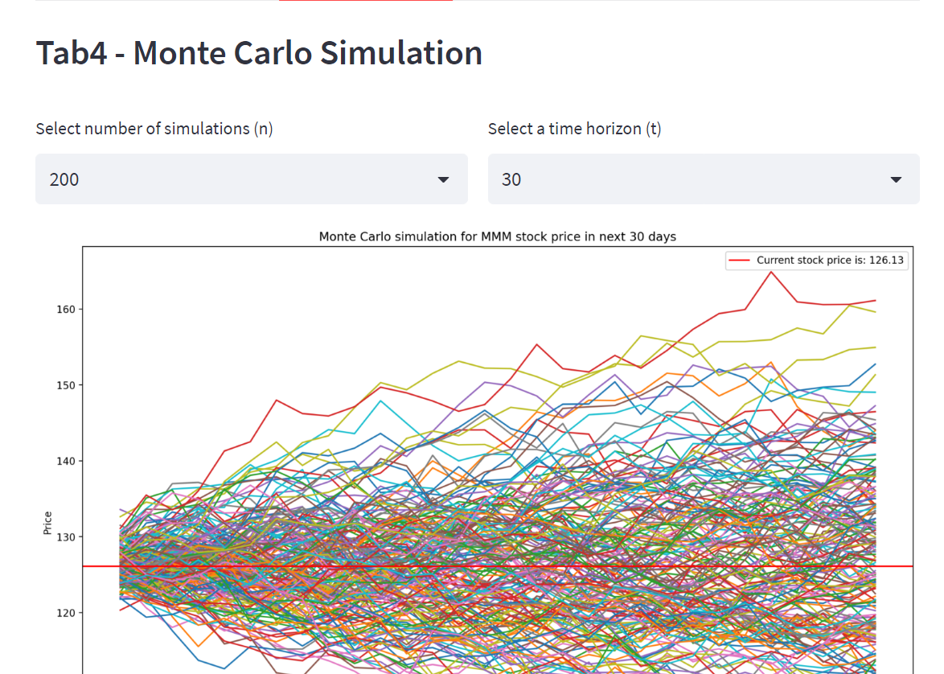
TAB4
Stock prediction and VAR calculation

Slide 8
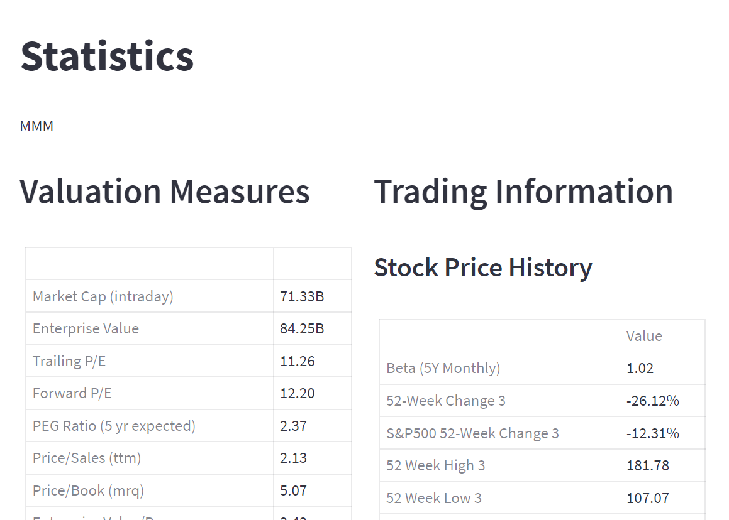
TAB 5
Statistical analysis

Slide 9
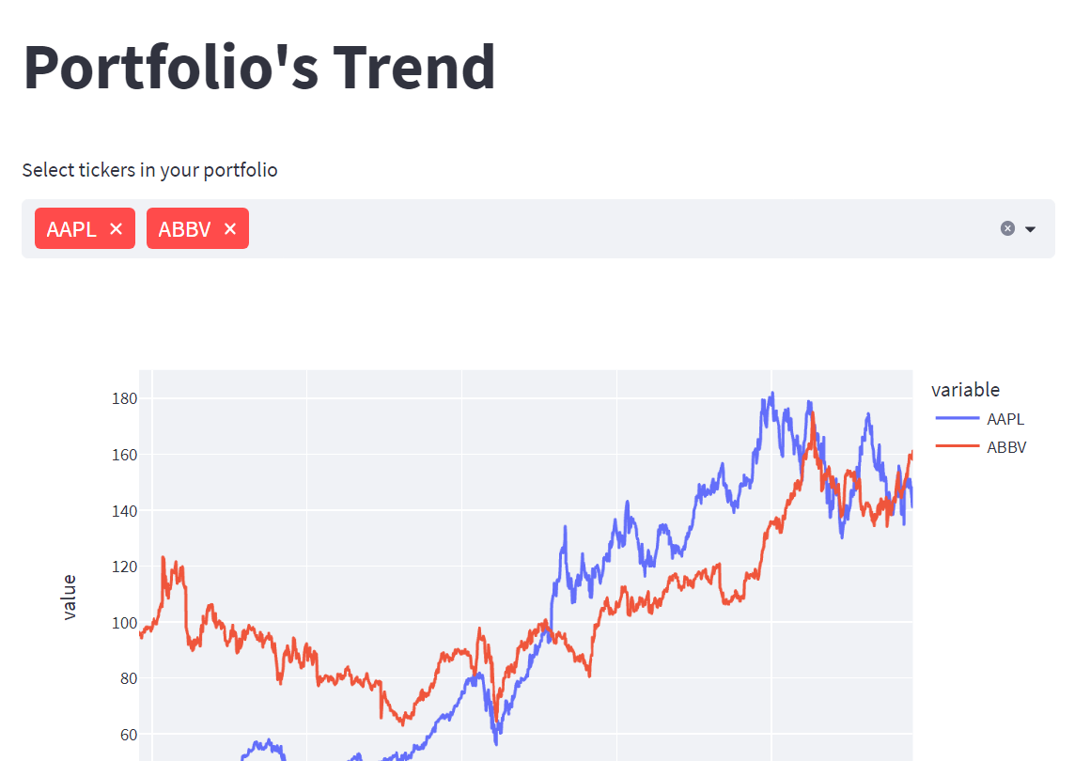
TAB 6
Multiple ticker selection to see different trends at once

Slide 10
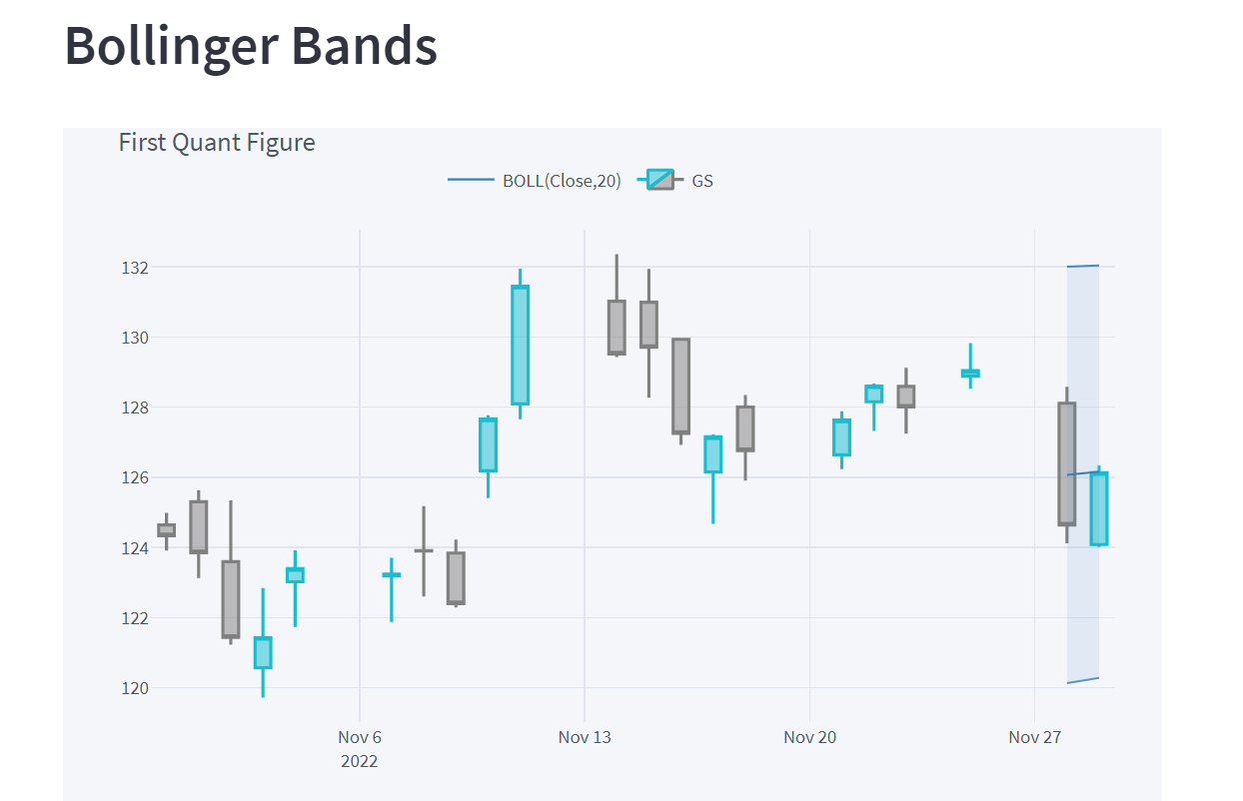

TAB 7
Company description and visualization

Slide 11
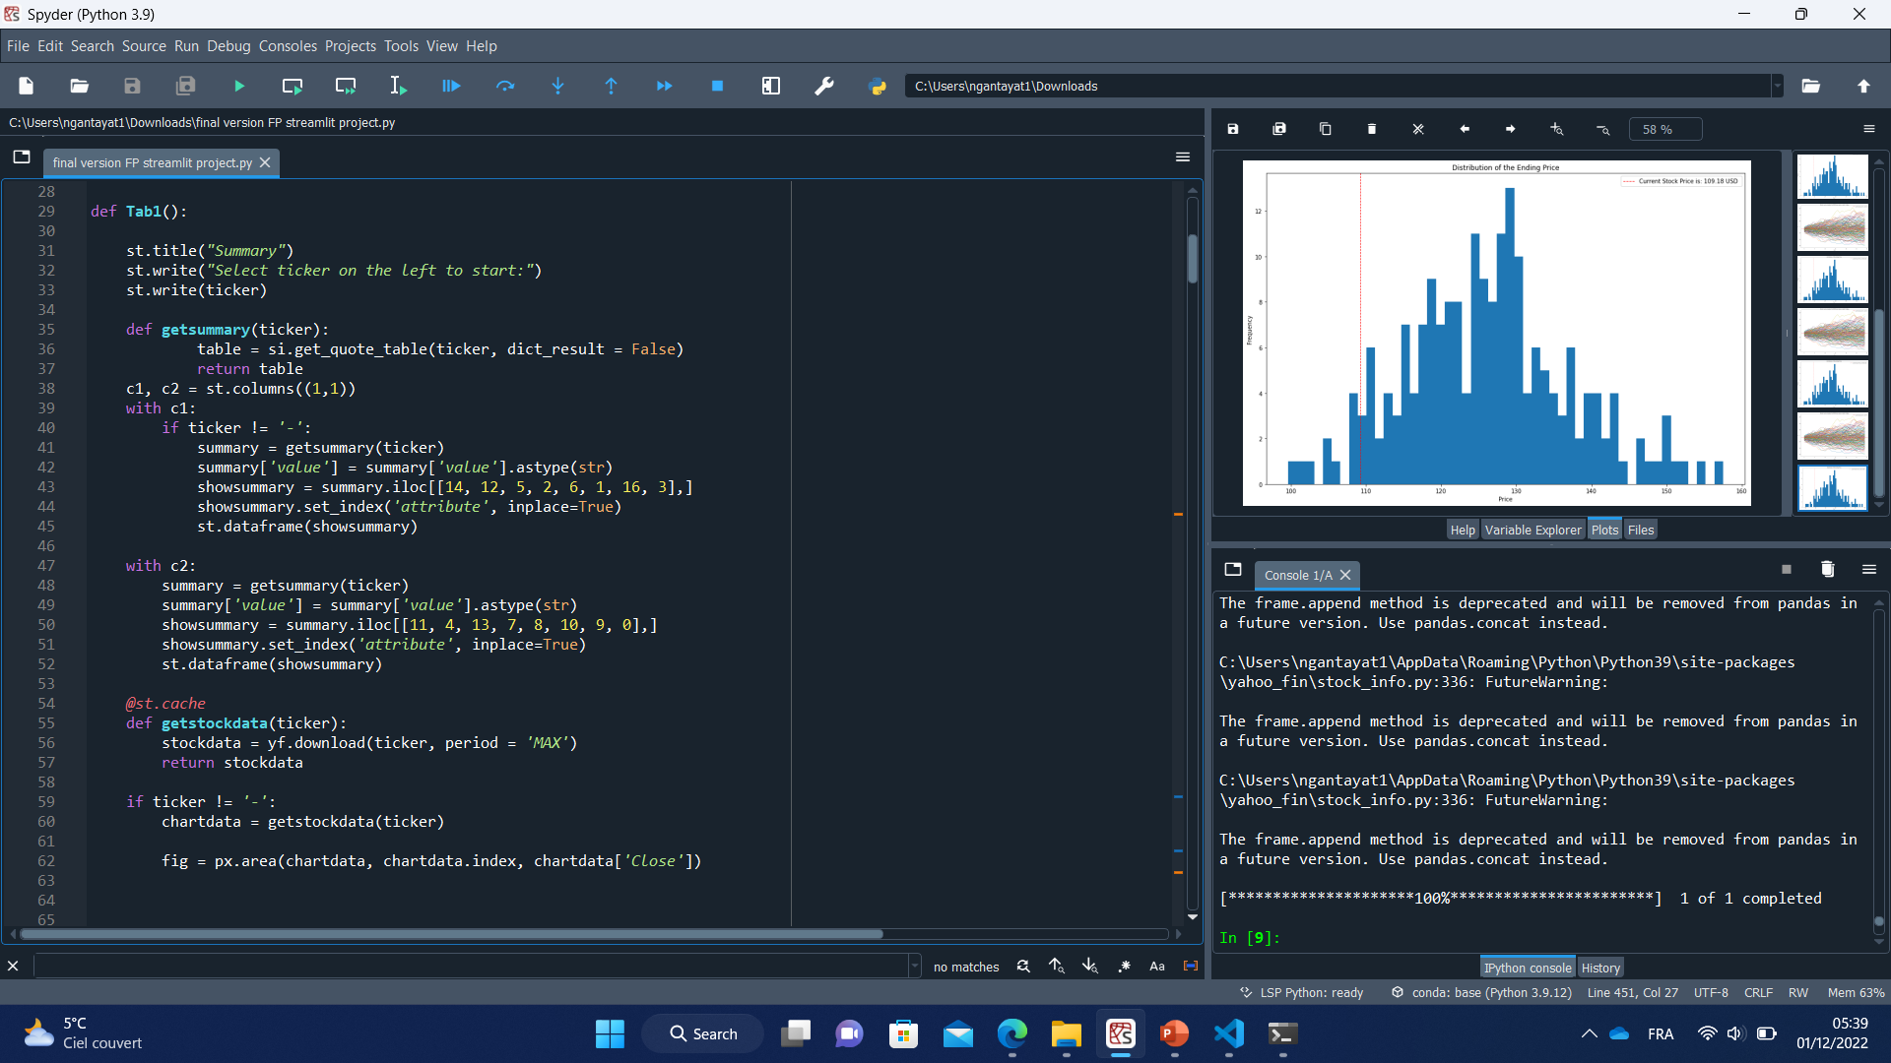
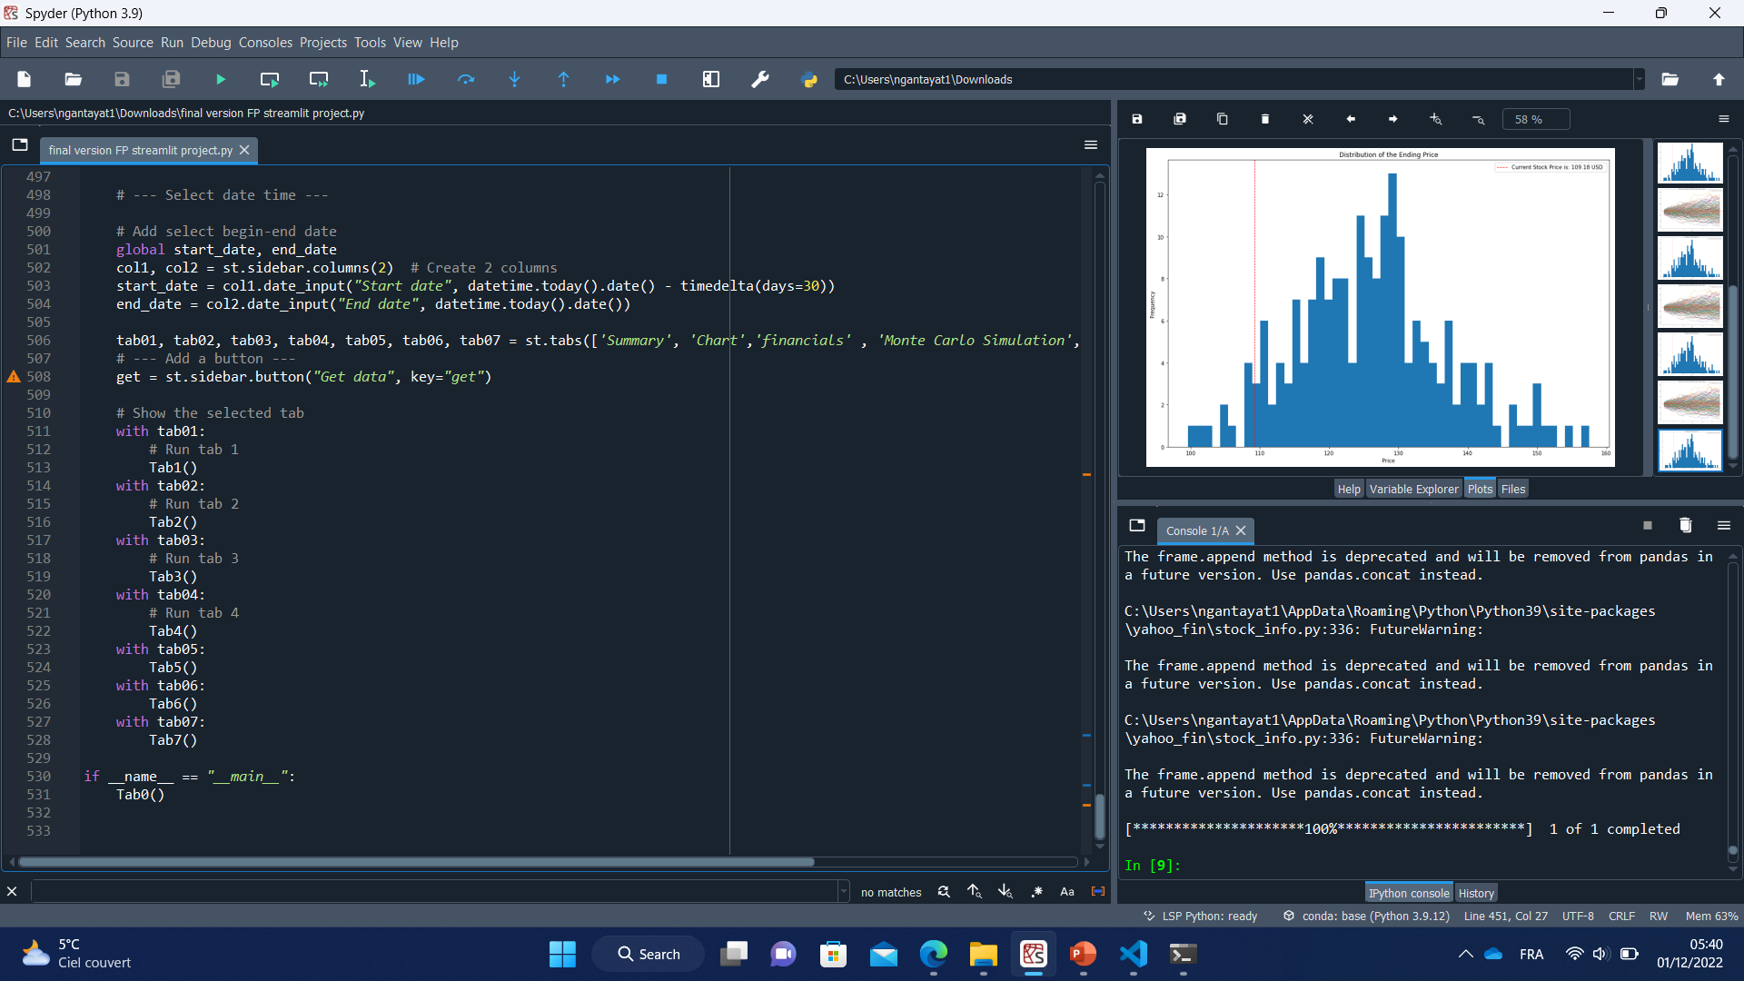
CODE EXTRACTS

Slide 12
REFERENCES
https://finance.yahoo.com/
https://blog.streamlit.io/introducing-new-layout-options-for-streamlit/
https://plotly.com/python/range-slider/
https://towardsdatascience.com/data-science-in-finance-56a4d99279f7
https://plotly.com/python/multiple-axes
https://plotly.com/python/candlestick-charts
https://en.wikipedia.org/wiki/List_of_S%26P_500_companies
https://medium.com/analytics-vidhya/beginners-python-financial-analysis-walk-through-part-6-ad396a787fd8
https://anaconda.org/conda-forge/cufflinks-py
https://blog.quantinsti.com/stock-market-data-analysis-python

Slide 13
APP DEPLOYMENT
https://github.com/nandinii27/data-analytics
https://nandinii27-data-analytics-finalversionfpstreamlitproject-z71arm.streamlit.app/

